Slide 1
Using Computer Vision to Explore How Consumers View Printed Advertisements
Sheela Ahmed
Advisor: Dr. Jeff Pelz
Committee members: Dr. Gabe Diaz and Dr. Chris Kanan

Slide 2
OVERVIEW
Introduction
Eye tracking – Pupil Labs
Summer Work
Analysis
Previous Work
Methods Process
Goals for end of semester and end of school year

Slide 3
What is the objective?
Analyze how individuals view printed advertisements in magazines

Slide 4
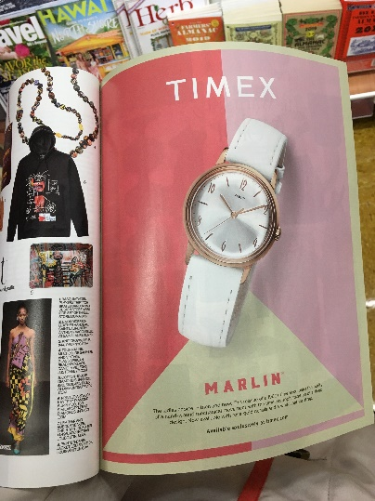
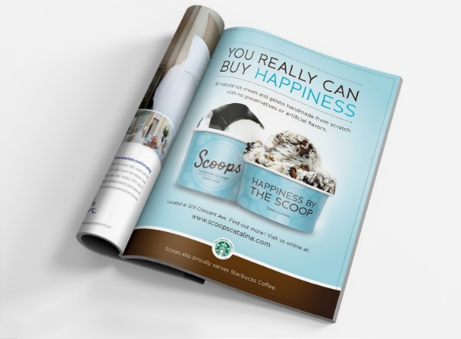
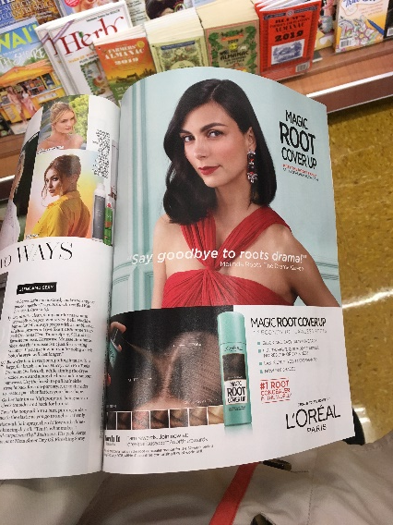
Introduction
To observe how individuals view advertisements in magazines, with primary focus on analysis and software
Advertisements in magazines
Portable eye trackers
Develop program

Slide 5
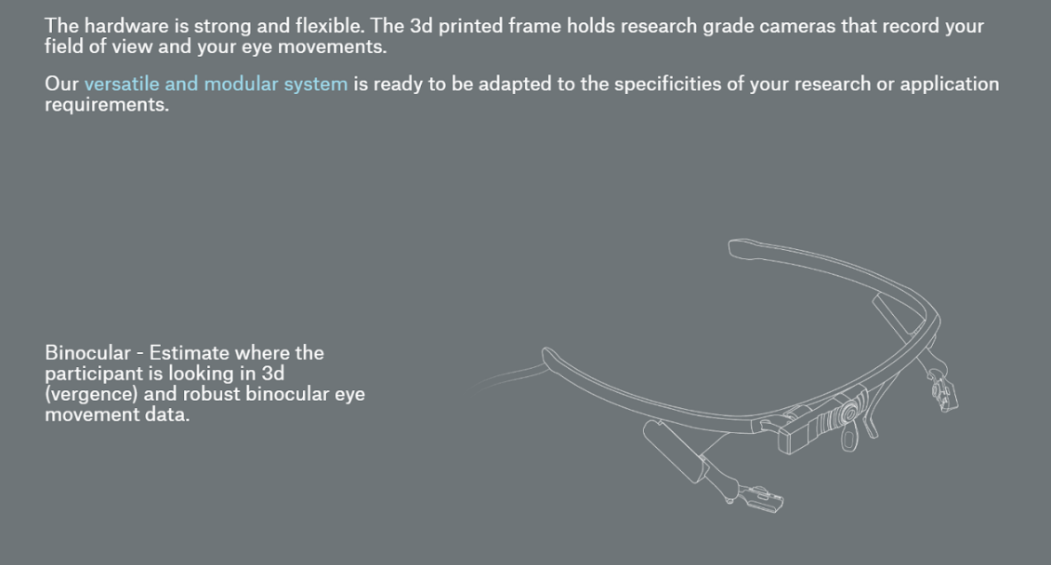
Eye trackers – Pupil Labs
Capture and analyze pupil data
Eye trackers also sold by Pupil Labs
Open source software created by Pupil Labs
Detect instances where person is maintaining visual gaze (fixation)
Display fixations as yellow circles with desired radius

Slide 6
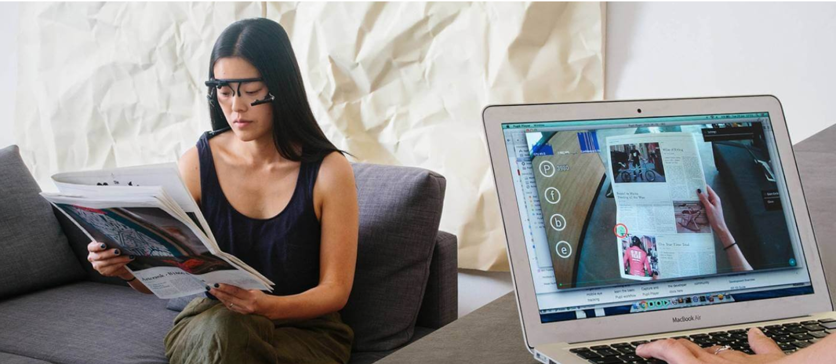

Slide 7
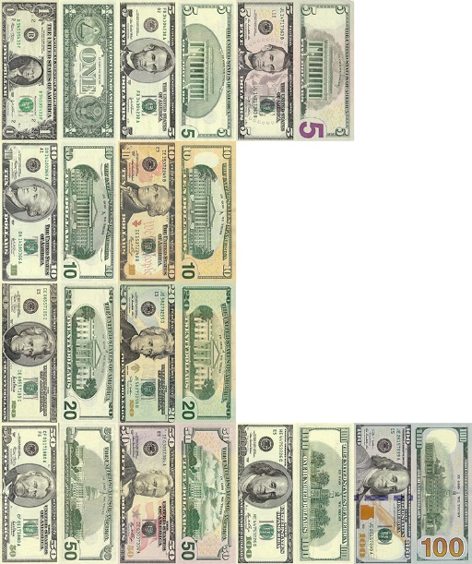
Summer work
NAS funded project on cash handling
Utilized Pupil Labs eye trackers and software
Similar analysis algorithm
Plugin for Pupil Player written by Dr. Gabe Diaz to detect fixations using saccadic movements
Program written by Dr. Jeff Pelz to map fixations from video to objects in visual library
Program written by Dr. Gabe Diaz to map fixations within object to ROIs

Slide 8
Analysis - Program
Most intensive portion of project
Both Jeff and Gabe’s aren’t integrated
Optimize and make code functional for use in various studies
Validation
Construct program to detect objects in fixations to visual library of various products (i.e. phone, makeup, shampoo, medicine)
feature detection
Notes:
MOST EMPHASIS ON THIS PORTION
Gabe’s code depends on output from Jeff’s code but they aren’t integrated with one another.
Goal: Create one program to complete both analyses.
Validation: not only optimize but validate and test code against various situations
Want it to be used in the future for different studies, not just be exclusive to this study and data.

Slide 9
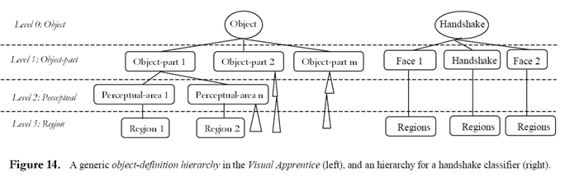
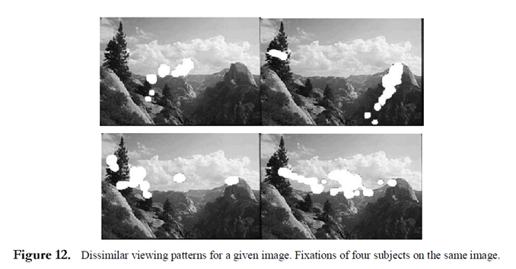
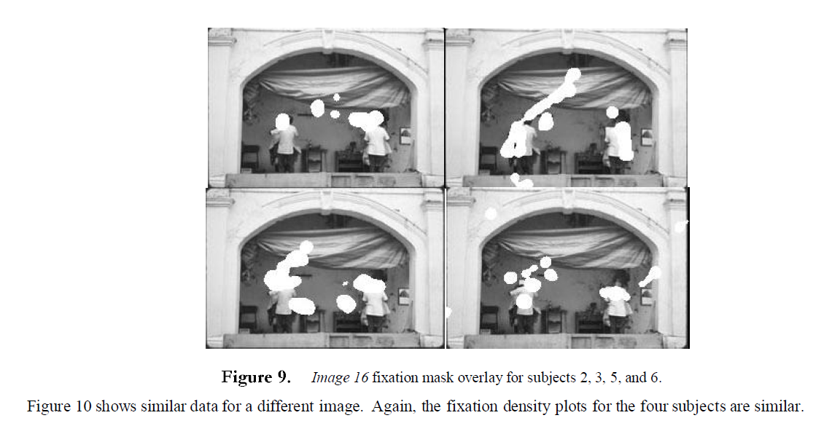
Previous Work - Automatic Image Classifiers, 2001
Alejandro Jaimes, Jeff Pelz, Tim Grabowski, Jason Babock and Shih-Fu Chang
Develop automatic image classification by exploring how people look at images of different semantic categories
Handshake, landscape, crowds
Visual Apprentice
Object definition hierarchy
User input to label frames and regions
Feature vectors (color, texture)
nearest neighbor

Slide 10
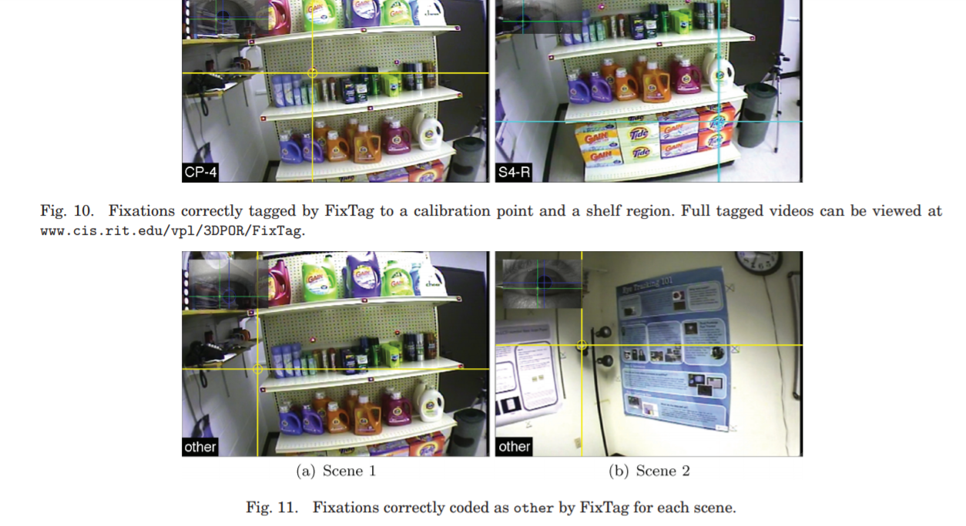
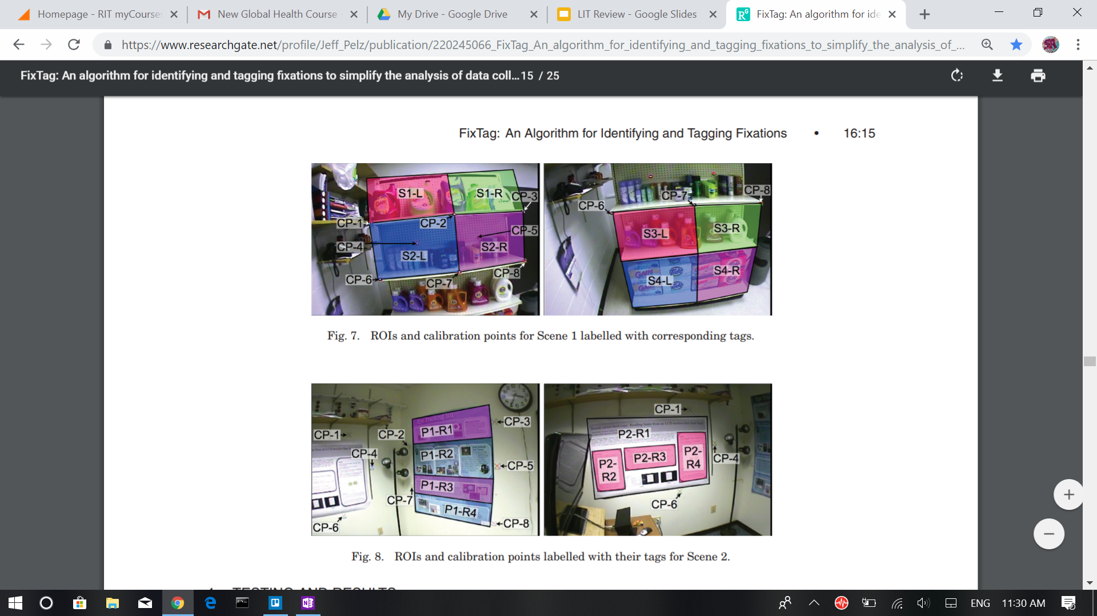
Previous Work - Fixtag, 2009
Susan Munn and Jeff Pelz
Automatic identification of fixations
Tag each fixation to an ROI
Requires 3D positions of vertices of ROIs and calibration of scene camera
Camera projection matrices → 3D ROI vertices → POR matched to closes keyframe → 2D projected ROI vertices
requires a manual calibration of 8 reference points in selected keyframes
establish a reference for the tracking.

Slide 11
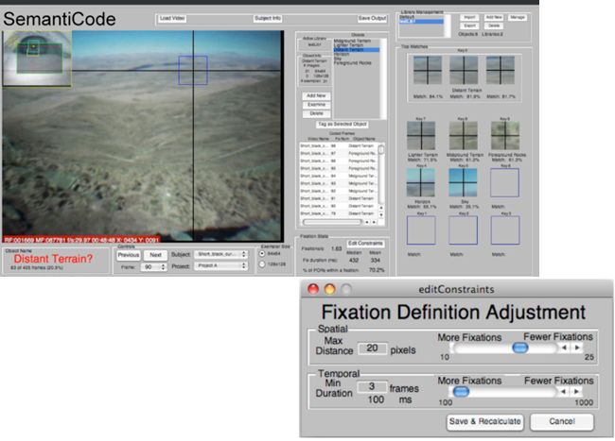
Previous Work - SemantiCode, 2010
Daniel Pontillo, Thomas Kinsman, and Jeff Pelz
Objective: create an object-recognition system that incorporated fixations and visual libraries to identify objects and regions
Involves GUI
Start with empty library and build it up using frames of interest
Algorithm independent of shape/spatial configuration → no need to separate object from background
Now called GazeTag and sold by some rich company

Slide 12
Methods Process
Main emphasis on program
Verify and test program on data collected of magazines
Collect data
Subjects
Magazines
Eye tracker
Pupil Player

Slide 13
Feature Detection: SIFT, SURF, ORB
Paper written in 2017 by Ebrahim Karami, Siva Prasad, and Mohamed Shehata
Testing various feature detection algorithms
Accuracy and robustness against rotation, scaling and deformity (due to horizontal and vertical shears and fish eye)
Results showcased ORB was the fastest algorithm while SIFT performed the best
In rotation, ORB and SURF outperformed SIFT in noisy images

Slide 14
Feature Detection: SIFT, SURF, ORB
SIFT
SURF
ORB
Scale Invariant Feature Transform
4 basic steps:
Estimate scale space extrema using DoG
Key point localization by eliminating low contrast points
Key point orientation based on image gradient
Descriptor generator based on image gradient mag. And orientation
Speed Up Robust Feature
Approximation of SIFT
Approximates DoG using box filters
BLOB detector (based on Hessian matrix) to find key points
Wavelet responses for orientation (by applying Gaussian weights
Also used to get descriptors
Orientated FAST and Rotated BRIEF
Used FAST key point detector and BRIEF descriptor
With FAST, also uses HARRIS corner detection to find the top key points
BRIEF descriptor
Rotation matrix computed using orientation of patch then BRIEF
Notes:
WAVELET: In order to achieve rotational invariance, the orientation of the point of interest needs to be found. The Haar wavelet responses in both x- and y-directions within a circular neighbourhood of radius {\displaystyle 6s} around the point of interest are computed, where {\displaystyle s} is the scale at which the point of interest was detected
SURF: wavelet responses in both horizontal and vertical directions by applying adequate Gauss weights. A neighborhood around the key point is selected and divided into subregions and then for each subregion the wavelet responses are taken and represented to get SURF feature descriptor.
ORB: with FAST, It computes the intensity weighted centroid of the patch with located corner at center. The direction of the vector from this corner point to centroid gives the orientation.

Slide 15
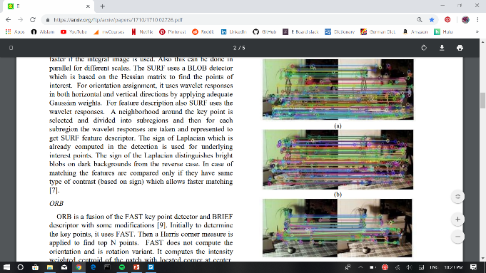
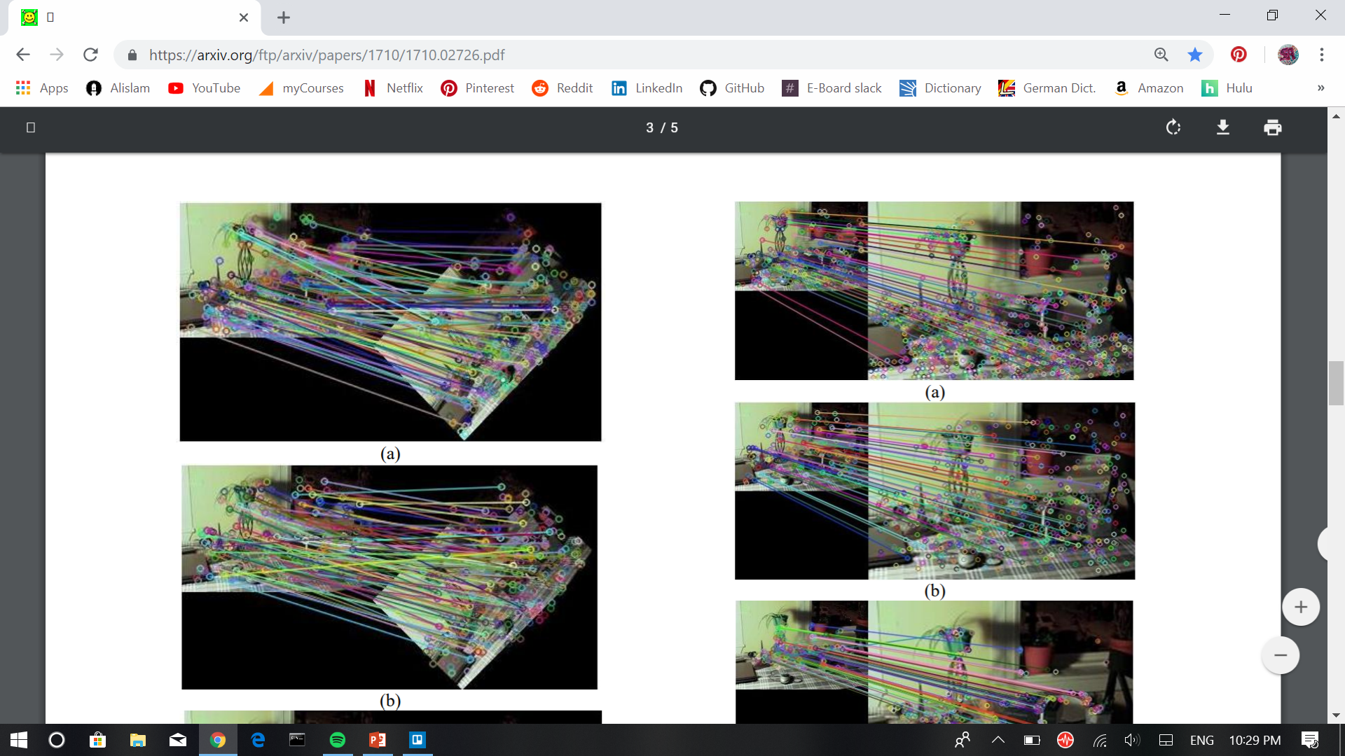
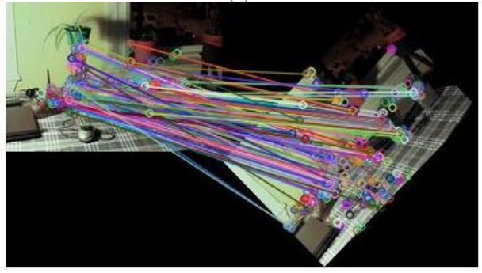
Feature Detection: SIFT, SURF, ORB
SIFT
SURF
ORB
Notes:
TOP IMAGES: The matching of varying intensity images using, SIFT, SURF, ORB.
BOTTOM IMAGES: The matching of the original image with its rotated image using: SIFT , SURF, ORB.

Slide 16
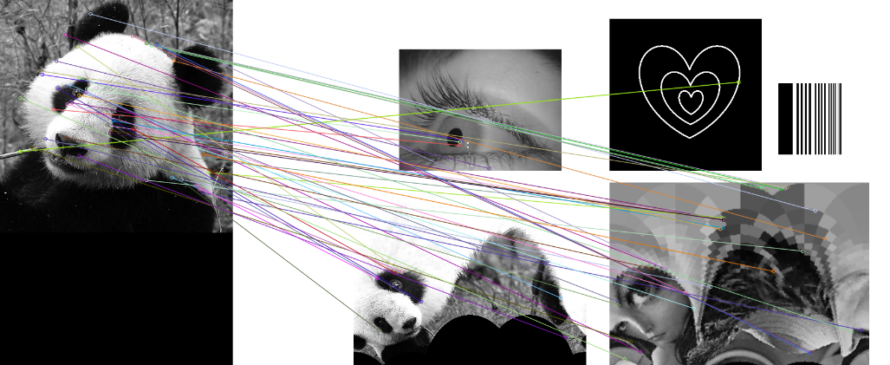
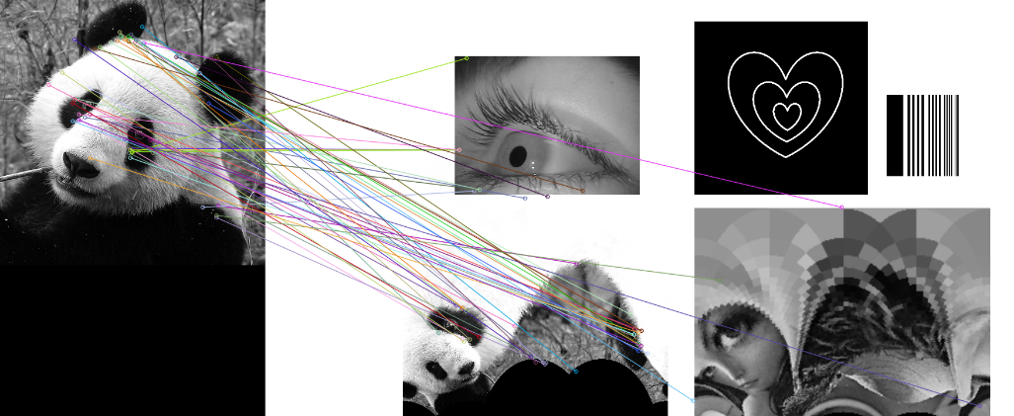
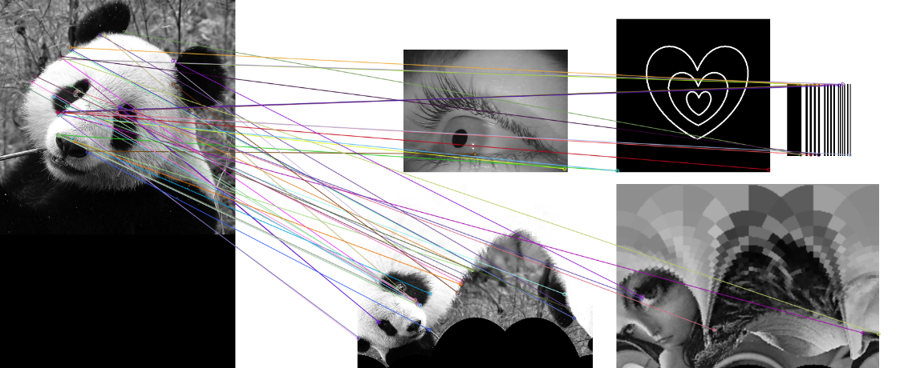
Own Results for SIFT, SURF, and ORB
SIFT
SURF
ORB
Notes:
Include data you’ve collected using ORB so far
Mention issues with PyAV ughsdhfjdsf

Slide 17
Goal for End of Semester
Continue feature detection and flowcharts for entire program
Struggle installing PyAV
Get that to work!
Start finding the best matches with different images to test out

Slide 18
Goal for the Very End
Have a complete, functional program
Optimize as much as possible
Run study
Set up environment and collect subjects’ data
Detect fixations and run through *functional* program to detect the objects and return results

Slide 19
Acknowledgements
Dr. Jeff Pelz
Dr. Gabe Diaz
Dr. Chris Kanan

Slide 20
Resources
Karami, Ebrahim, Siva Prasad, and Mohamed Shehata. "Image matching using SIFT, SURF, BRIEF and ORB: performance comparison for distorted images." arXiv preprint arXiv:1710.02726 (2017).
“Pupil Player Release.” Pupil Labs - Pupil, pupil-labs.com/blog/2014-02/pupil-player-release/.

Slide 21
Questions?

